Slide 1

Stamford Blood Donor System
Group Name Thinker’s
Presented by
Sajib Roy
Faisal Chaklader
Joydeb Paul Anupam

Slide 2
Objective
Construct meaningful interview questions
Understanding the client & organization’s
Understanding the current system
Requirement & features Analysis
Creating Use case diagram
Creating data flow diagram
Questionnaires & Interview Pattern

Slide 3
Interview structure was Funnel type
6 open ended question in beginning.
2 close ended question after that.
Question Type Funnel.
Interview Structure

Slide 4
Questionnies
Total Interview Procedure:
Question 01 : How do you know if the donor blood is safe to use or not?
Answer : Blood cross matching and screening test if there any problem with the donor blood.Question 02 : Do you come here to donate blood voluntarily?
Answer : Yes.
Question 03 : Do you do blood test before the blood donates blood?
Answer : In Screening test there are Hepatitis C virus (HCV), human immunodeficiency viruses (HIV), (VDRL), (CPHA), (CP) risk normally these are screening test to see if the blood is safe.
Question 04 : How many disease test you do before the donor donates blood 2 and 3 same question but different meaning ?
Answer : Actually without screening test we can’t push patients. And without blood test blood shouldn’t apply to patients.By screening testing we after push blood from donor to patients. Screening test must before give blood.

Slide 5
Questionnies
Question 05 : How do you handle rare blood type case in an emergency?
Answer : If the hospital has the rare blood the patient need they will do there best to provide the blood if not then they will check their other branch if they have anyone blood donor who match patients blood they can push from donor to patients. Generally rare case blood is all negative blood groups(A-,B-,AB-,O-).
Question 06 : How do you motivate someone to donate blood?
Answer : They provide service and they take good care for donor but if the donor doesn’t want no one can force them.
Question 07 : How many blood bank service does your hospital branch have ?
Answer : Each Islamic hospital has their own blood bank service. Total eleven branch. Specially Dhaka five branch where have blood bank.
Question 08 : Is your blood bank government licensed ?
Answer : Yes.

Slide 6
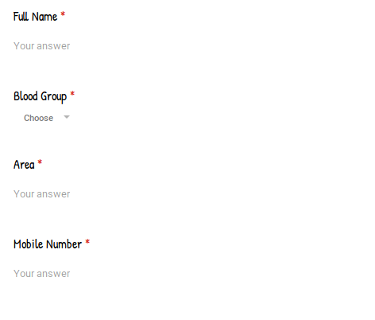
Questionnies

Slide 7
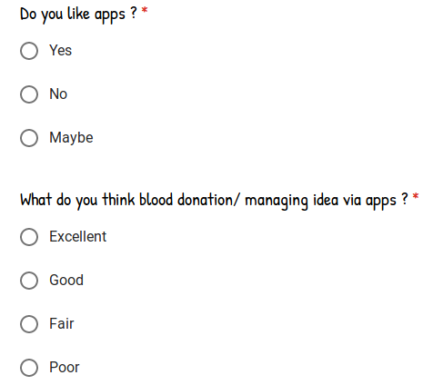
Questionnies

Slide 8
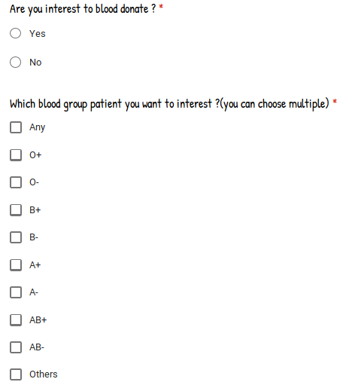
Questionnies

Slide 9
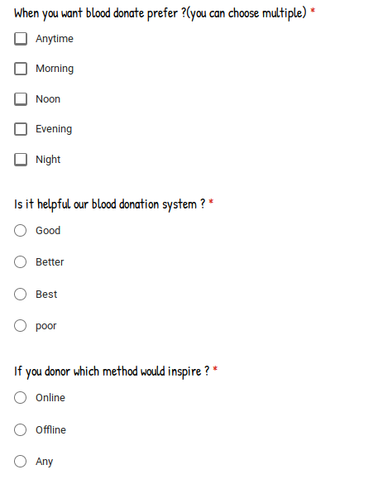
Questionnies

Slide 10
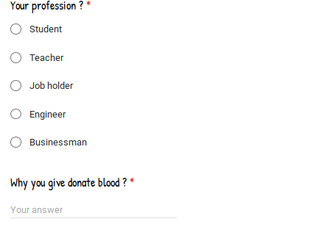
Questionnies

Slide 11
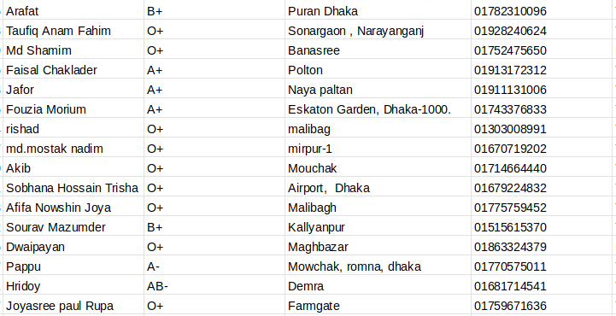

Slide 12
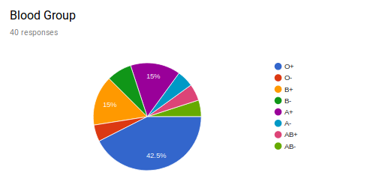

Slide 13
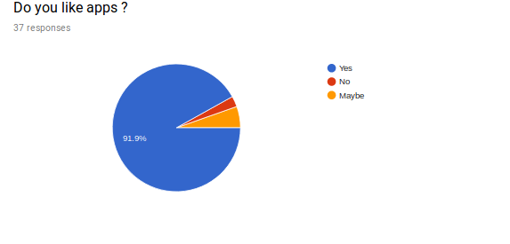

Slide 14
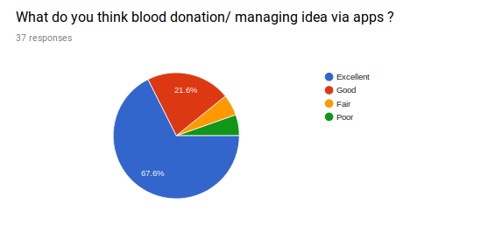

Slide 16
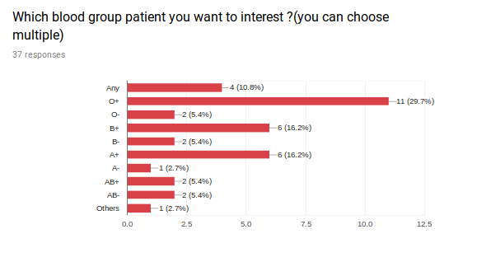

Slide 17
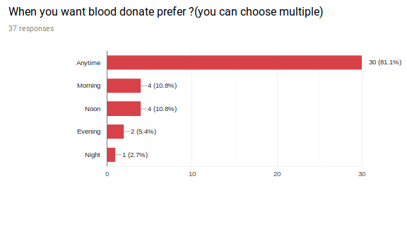

Slide 18
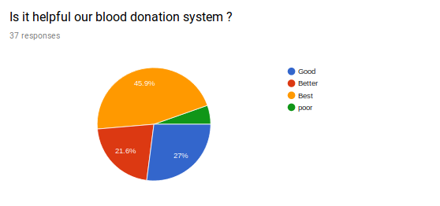

Slide 19
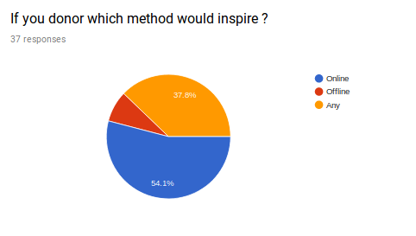

Slide 21
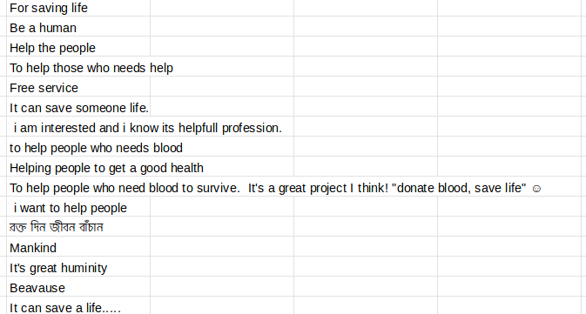

Slide 22
Thank you

